Slide 1

Prepoznava defektov na lesnih deskah
Strojni vid
Prva predstavitev seminarske naloge
Avtor: Miha Ožbot
Mentor: doc. dr. Janez Perš
Ljubljana, december 2021

Slide 2
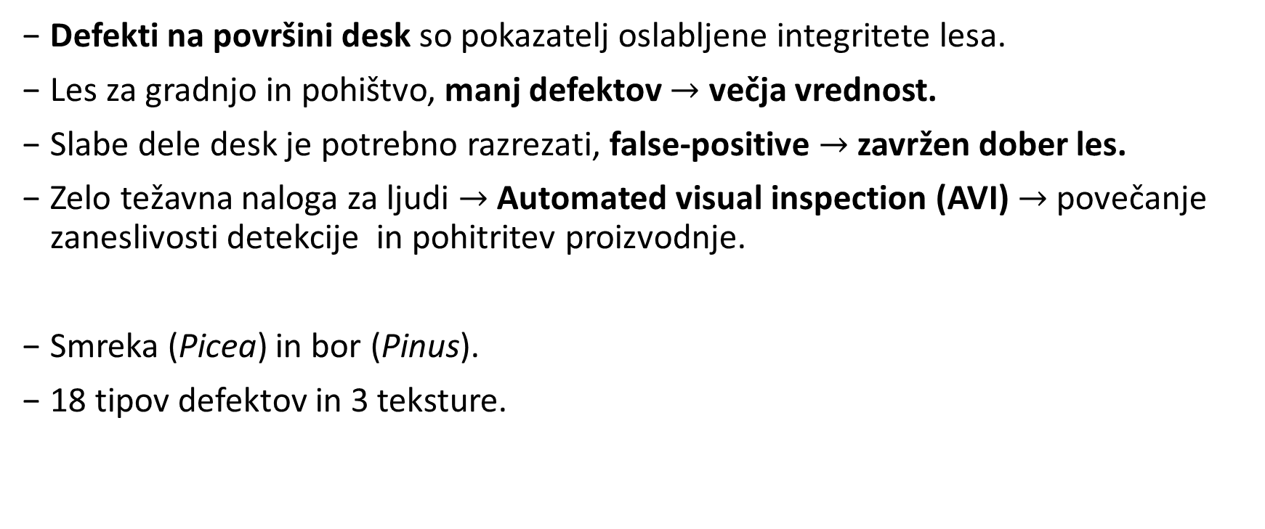
Definicija problema
Defekti na površini desk so pokazatelj oslabljene integritete lesa.
Les za gradnjo in pohištvo, manj defektov $→$ večja vrednost.
Slabe dele desk je potrebno razrezati, false-positive $→$ zavržen dober les.
Zelo težavna naloga za ljudi $→$ Automated visual inspection (AVI) $→$ povečanje zaneslivosti detekcije in pohitritev proizvodnje.
Smreka (Picea) in bor (Pinus).
18 tipov defektov in 3 teksture.
Notes:
Primarno blue stain

Slide 3
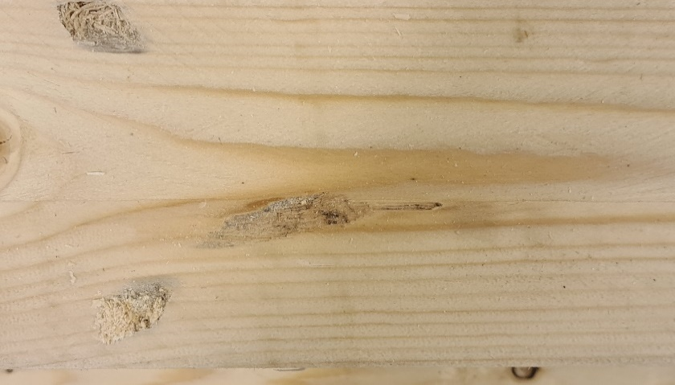
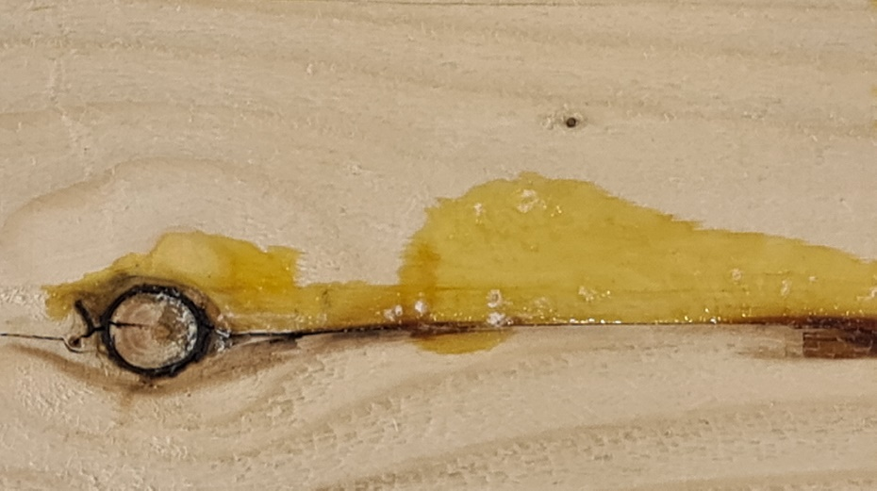
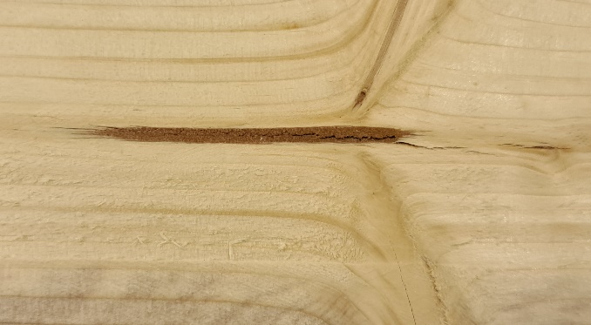
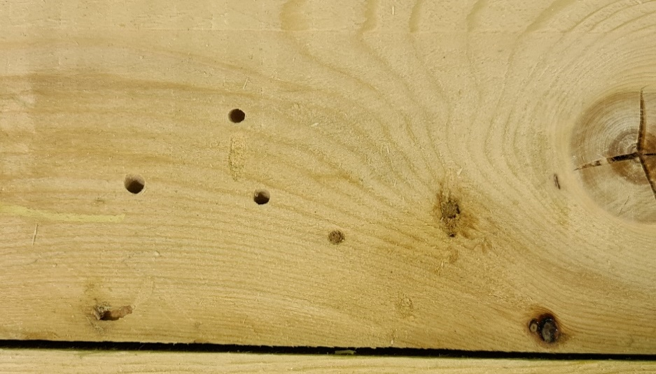
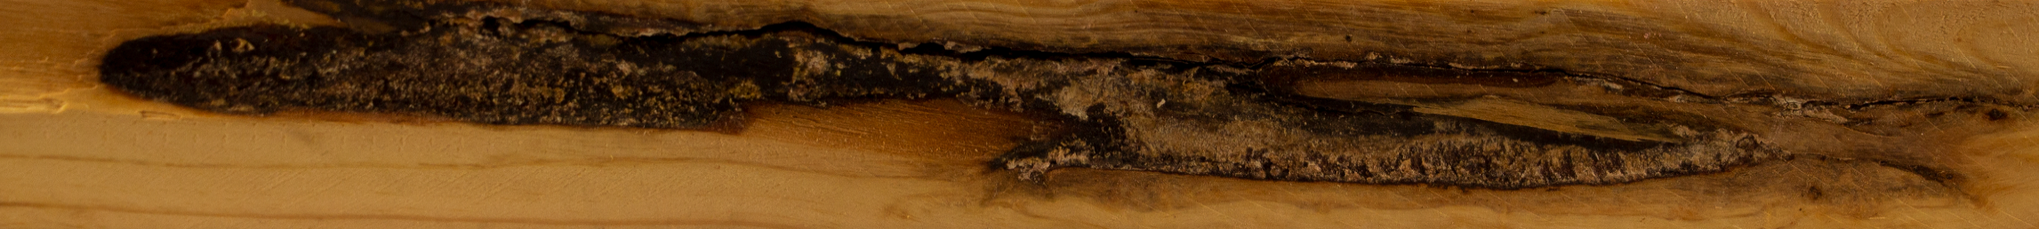

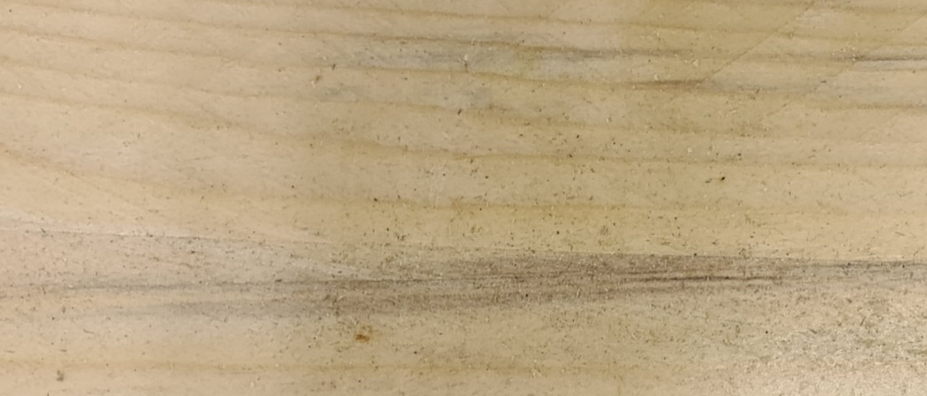
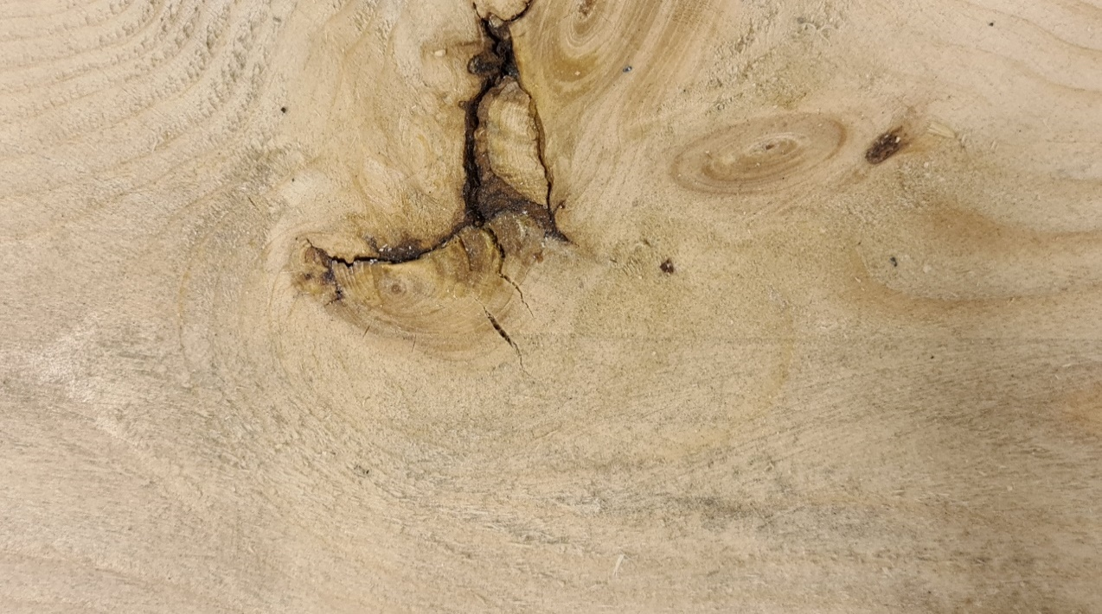
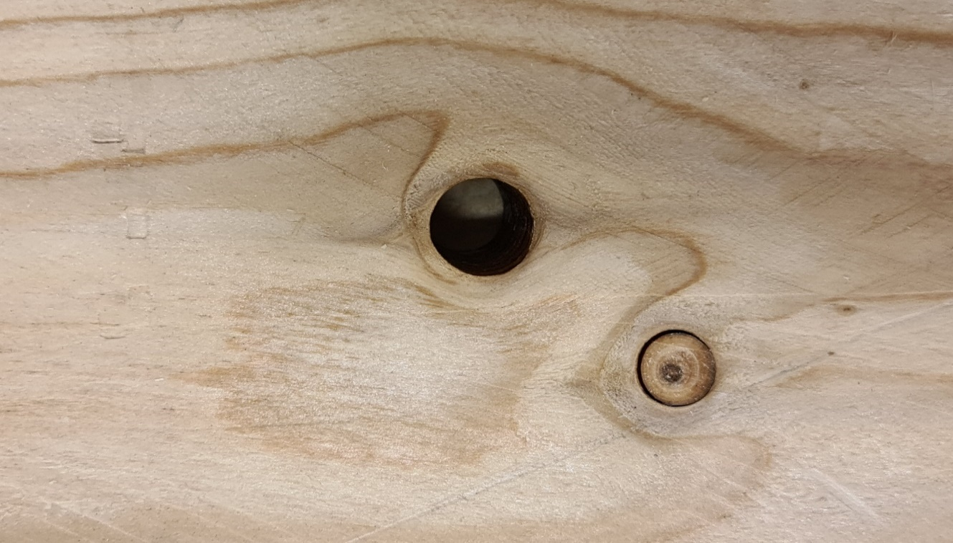
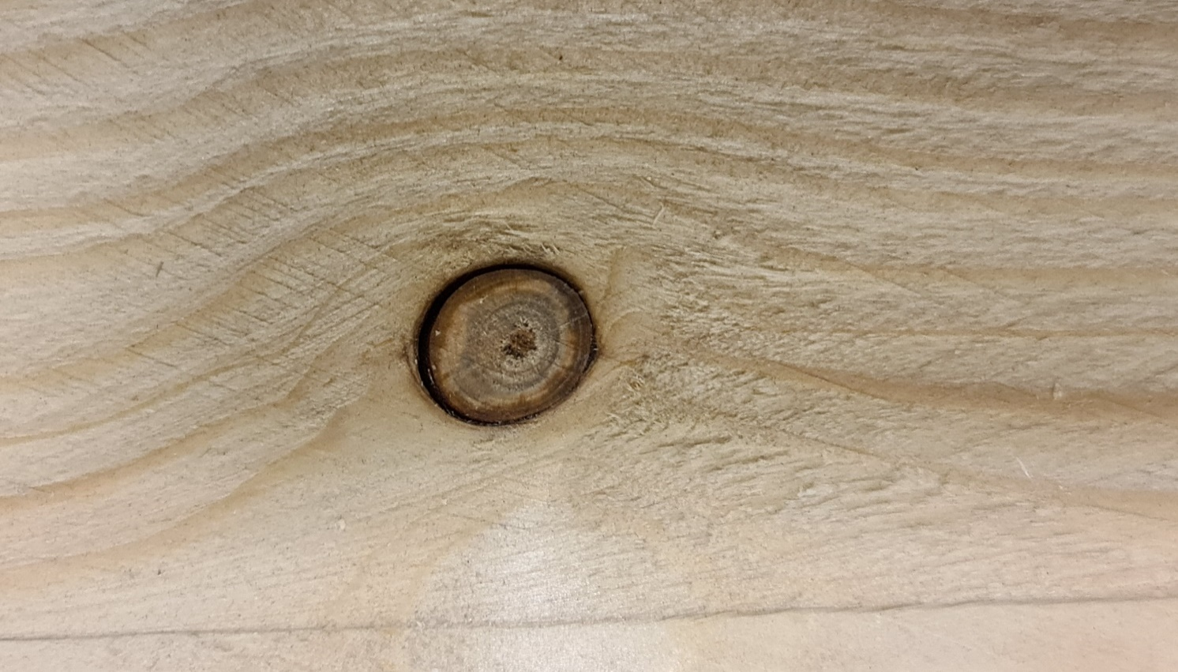
BLACK KNOT
BLACK KNOT
BLUE STAIN
FIBER DAMAGE
BLACK KNOT
BLACK KNOT
BLACK KNOT
ROT AND DECAY
BLACK KNOT
BARK POCKET
BLACK KNOT
FIBER DAMAGE
BLACK KNOT
PITH (JEDRO)
WORM HOLE
WORM GALLERY
RESIN (SMOLA)
ROT AND DECAY
BLUE STAIN (MODRI MADEŽI)
BARK POCKET (ŽEPKI LUBJA)
FALLEN KNOT
BLACK KNOT (MRTVA GRČA)
Notes:
Bark pocket, pith
Kako postaviti meje, če potrebujemo označit z kvadratom
Klasifikacija
Segmentacija

Slide 4
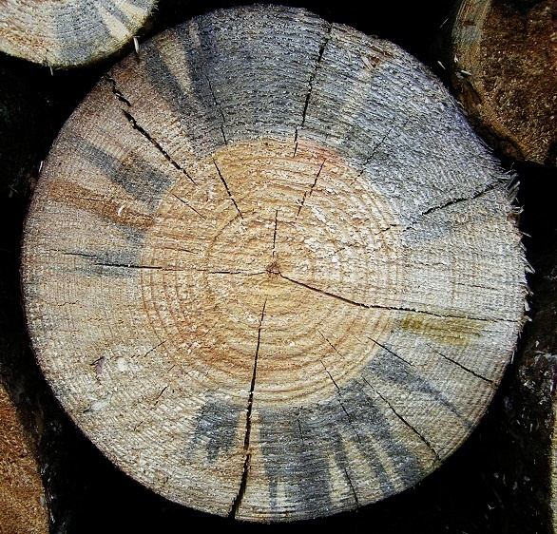
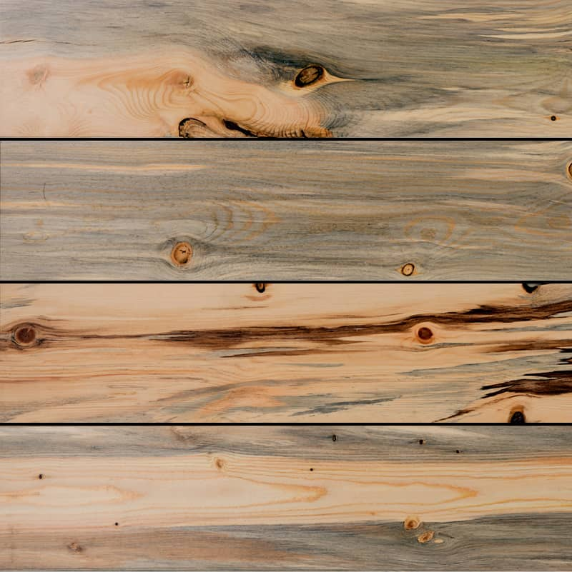
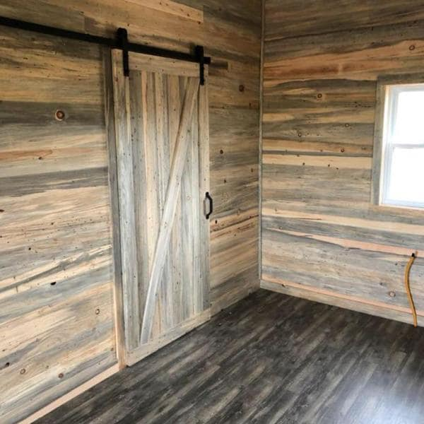
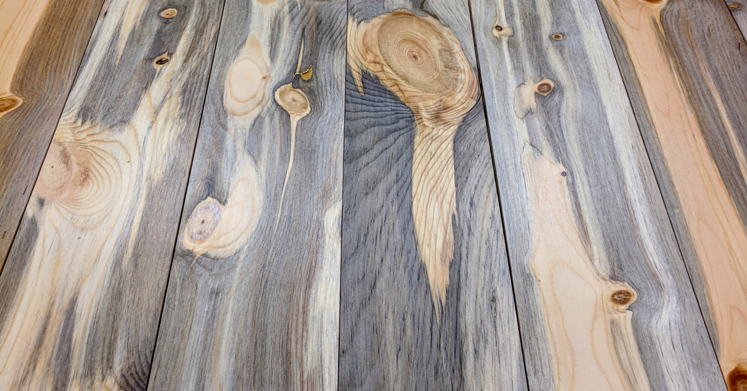
Blue stain

Slide 5
Določanje značilk (feature extraction)
detekcija robov (Sobel),
lokalno upravljanje (Otsu),
wavelet transform (Daubechies),
gray level co-occurrence matrix (GLCM),
local binary patterns (LBP),
Law‘s texture energy measures (LTEM),
speeded-up-robust-feature (SURF),
variance of variance (VOV),
order statistics.

Slide 6
Razvrščanje (classification) in razčlenjevanje (segmentation)
principal component analysis (PCA),
linear discriminant analysis (LDA),
support vector machine (SVM),
k-nearest neighbors (KNN),
random-forest, classification and regression tree (CART),
convolutional neural network (CNN);
AlexNet, VGG-16, DeCAF, ResNet, Inception net,
multinomial logistic regression (MLR).

Slide 7
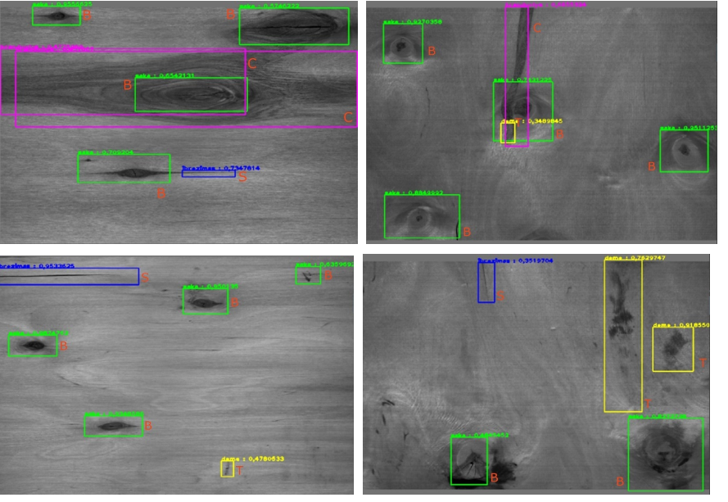
Automated identification of wood veneer surface defects using faster region-based convolutional neural network with data augmentation and transfer learning (2019)
Faster R-CNN, območja in klasifikacija
5 razredov defektov, 3540 defektov
„…\ pre-trained AlexNet, VGG16, BNInception, and ResNet152 neural network \...“
„The best average accuracy was obtained using the pretrained ResNet152 neural network model (80.6%), while by combining all the defect classes into one type, 96.1% accuracy in finding surface defects was achieved.“
Notes:
Polska, litva, 2019
Region based convolutional neural network

Slide 8
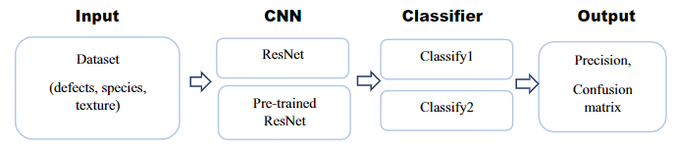
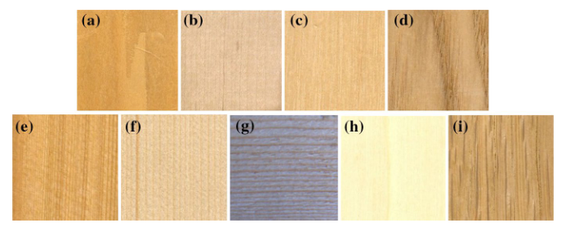
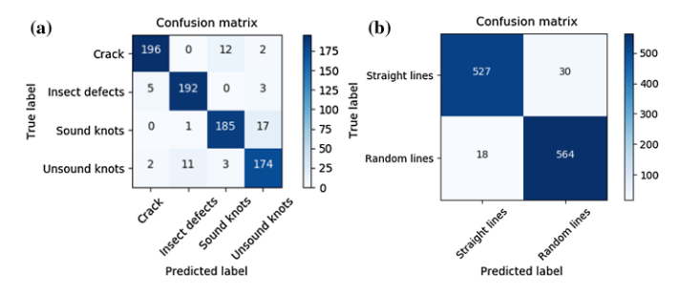
Deep learning for use in lumber classification tasks (2019)
ResNet18, klasifikacija defektov in teksture lesa
4 razredov defektov, 2 teksturi, 1693 defektov
„ …\ the classification accuracy of datasets is observed to be 98.16%, 93.32%, 96.64% and 99.50%, respectively, for each dataset.“
Notes:
China,Usa

Slide 9
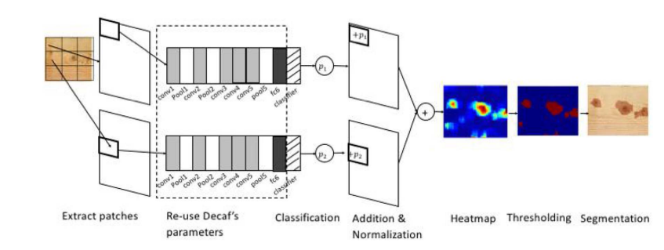
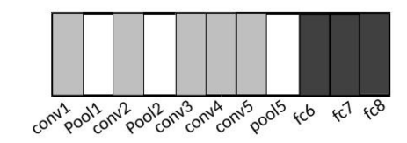
A Generic Deep-Learning-Based Approach for Automated Surface Inspection (2017)
DeCAF CNN, heatmap, klasifikacija in segmentacija
Heatmap („For each defect class, a heat map is obtained by iteratively adding the probabilities pixel-wise.“)
Otsu’s thresholding (minimizes intraclass variance), Felzenswalb’s segmentation („This algorithm is a graph-based method that groups pixels by their color similarities.“)
Notes:
Singapur
Hong Kong

Slide 10
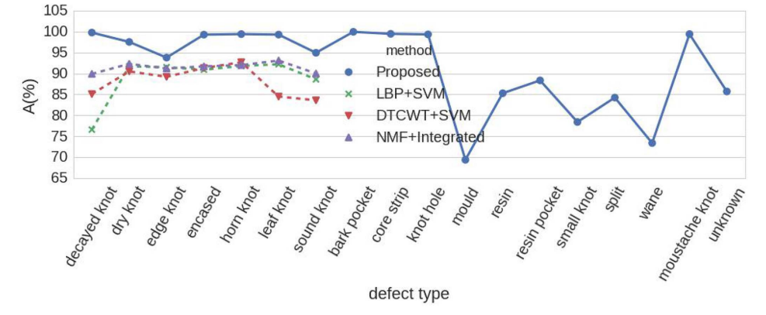
A Generic Deep-Learning-Based Approach for Automated Surface Inspection (2017)
438 slik desk s 7 razredov defektov in 839 slik desk z 18 razredov defektov
Notes:
local binary pattern (LBP)
dual-tree complex wavelet transform (DTCWT)
nonnegative matrix factorization (NMF)

